Slide 1
Genetic Algorithm

Slide 2
Introduction
Limitations of Traditional Optimization Approaches
Computationally expensive
For discontinuous objective function, methods may fail
Discrete integer variables are difficult to handle
Methods may not be necessarily adaptive
Evolutionary algorithms have been developed to handle the above problems

Slide 3
Evolutionary Algorithms
Algorithms that follow biological and physical behaviors:
Biological Behaviours
Genetics and Evolution: Genetic Algorithm
Behavior of Ant Colony: Ant Colony Optimization
Human Nervous System: Artificial Neural Network
Physical Behaviors
Annealing Process: Simulated Annealing
Swarming of Particle: Particle Swarm Optimization
Learning: Fuzzy Logic

Slide 4
Genetic Algorithms
It is a specific type of evolutionary algorithm
Suitable to solve problems that are computationally hard and involve large number of parameters (discrete or continuous): Combinatorial Optimization Problems
First time introduced by Prof. John Holland in 1965. But the first article was published in 1975.
Provide efficient, effective techniques for optimization and machine learning applications
Widely-used today in business, scientific and engineering circles
Principles of GA are based on two fundamental biological processes:
Genetics: Gregor Johan Mendel (1865)
Evolution: Charles Darwin (1875)

Slide 5
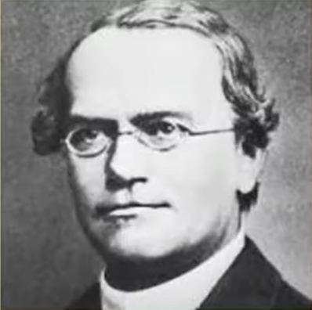
Genetics
The basic building blocks in living bodies are cells.
Each cell carries the basic unit of heredity called gene.
For a particular species, the number of chromosomes is fixed.
For example:
Mosquito: 8
Frogs: 26
Human: 46
Gregor Johan Mendel

Slide 6
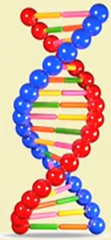
Genetics
Genetics is built around molecules called DNA.
DNA molecules hold all the genetic information for an organism.
It provides cells with the information they need to perform tasks that allow an organism to grow, survive and reproduce.
A gene is one particular section of a DNA molecule that tells a cell to perform one specific task.
Spiral helix of protein substance called DNA
DNA code is used as a biometric trait
During reproduction, DNA is replicated and passed from a parent to their offspring. This inheritance of genetic material by offspring influences the appearance and behavior of the offspring.
https://basicbiology.net/biology-101/introduction-to-genetics#:~:text=The%20passing%20of%20traits%20from%20parents%20to%20offspring,inheritance.%20Genetics%20is%20built%20around%20molecules%20called%20DNA.

Slide 7
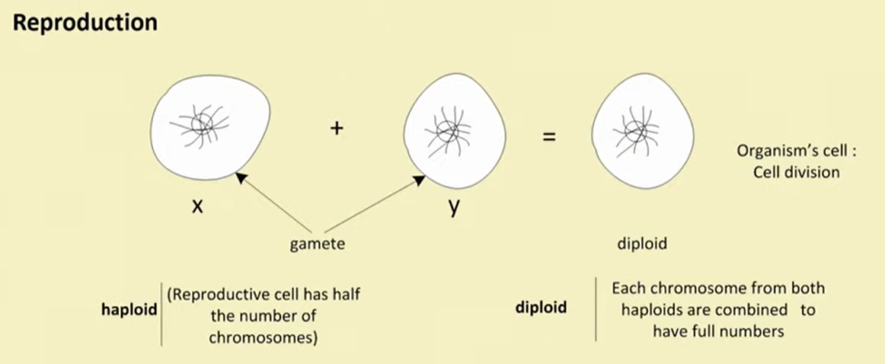
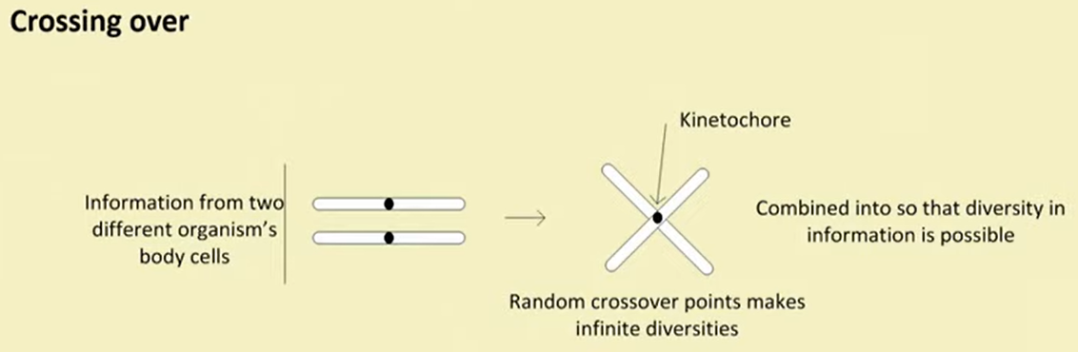
Genetics

Slide 8
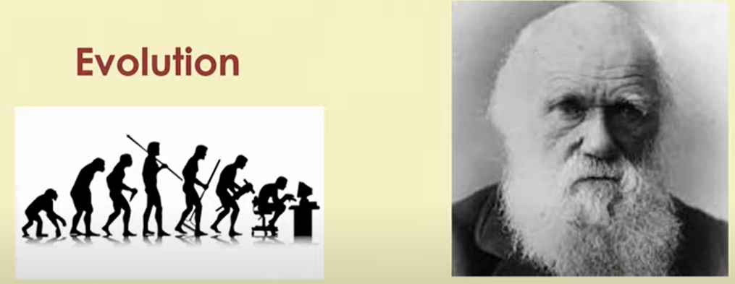
Evolution
Charles Darwin

Slide 9
Evolution
Four primary premises
Information Propagation: An offspring has many of its characteristics of its parents. Information passes from parent to its offspring) [Heredity]
Population diversity: Variation in the characteristics in the next generation [Population Diversity]
Survival for existence: Only a small percentage of the off-spring produced survive to adulthood [Selection]
Survival of the best: Offspring survived depends on their inherited characteristics [Ranking]

Slide 10
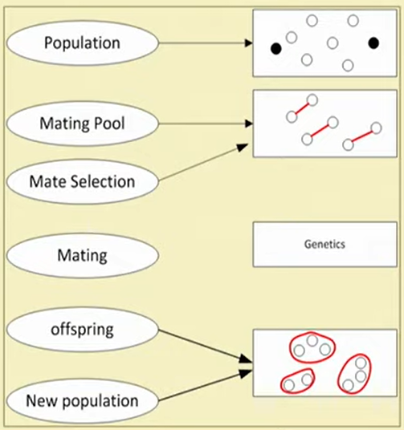
Biological Process: An Overview

Slide 11
Genetic Algorithms
Genetic Algorithm is a population-based probabilistic search and optimization technique that works based on the mechanisms of natural genetics and natural evaluation.
“Genetic Algorithms are good at taking large, potentially huge search spaces and navigating them, looking for optimal combinations of things, solutions you might not otherwise find in a lifetime.”
- Salvatore Mangano
Computer Design, May 1995

Slide 12
Components of a GA
A problem to solve, and ...
Encoding technique (gene, chromosome)
Initialization procedure (creation)
Evaluation function (environment)
Selection of parents (reproduction)
Genetic operators (mutation, recombination)
Parameter settings (practice and art)

Slide 13
GA Framework
Start
Initial Population
Converge?
No
Selection
Yes
Stop
Reproduction

Slide 14
Population
population
Chromosomes could be:
Bit strings (0101 ... 1100)
Real numbers (43.2 -33.1 ... 0.0 89.2)
Permutations of element (E11 E3 E7 ... E1 E15)
Lists of rules (R1 R2 R3 ... R22 R23)
... any data structure ...

Slide 15
Reproduction
children
reproduction
parents
population
Parents are selected at random with selection chances biased in relation to chromosome evaluations.

Slide 16
Chromosome Modification
children
Modifications are stochastically triggered
Operator types are:
Mutation
Crossover (recombination)
modification
modified children

Slide 17
Mutation: Local Modification
Before: (1 0 1 1 0 1 1 0)
After: (1 0 1 0 0 1 1 0)
Before: (1.38 -69.4 326.44 0.1)
After: (1.38 -67.5 326.44 0.1)
Causes movement in the search space (local or global)
Restores lost information to the population

Slide 18
Crossover: Recombination
P1 (0 1 1 0 1 0 0 0) (0 1 0 1 1 0 0 0) C1
P2 (1 1 0 1 1 0 1 0) (1 1 1 0 1 0 1 0) C2
Crossover is a critical feature of genetic algorithms:
It greatly accelerates search early in evolution of a population
It leads to effective combination of schemata (sub-solutions on different chromosomes)

Slide 19
Evaluation
modified
children
The evaluator decodes a chromosome and assigns it a fitness measure
evaluated
children
evaluator

Slide 20
Deletion
population
Generational GA: entire populations replaced with each iteration
Simple GA or Steady-state GA: a few members replaced each generation
discarded members
discard

Slide 21
An Abstract Example
Distribution of Individuals in Generation 0
Distribution of Individuals in Generation N

Slide 22
A Simple Example
The Traveling Salesman Problem:
Find a tour of a given set of cities so that
each city is visited only once
the total distance traveled is minimized

Slide 23
Representation
Representation is an ordered list of city
Numbers known as an order-based GA.
1) London 3) Dunedin 5) Beijing 7) Tokyo
2) Venice 4) Singapore 6) Phoenix 8) Victoria
CityList1 (3 5 7 2 1 6 4 8)
CityList2 (2 5 7 6 8 1 3 4)

Slide 24
Crossover
* *
Parent1 (3 5 7 2 1 6 4 8)
Parent2 (2 5 7 6 8 1 3 4)
Child (2 5 7 2 1 6 3 4)
This operator is called the Order1 crossover.

Slide 25
Mutation
Mutation involves reordering of the list:
* *
Before: (5 8 7 2 1 6 3 4)
After: (5 8 6 2 1 7 3 4)

Slide 26
TSP Example: 30 Cities

Slide 27
Solution _{i} (Distance = 941)

Slide 28
Solution _{j}(Distance = 800)

Slide 29
Solution _{k}(Distance = 652)

Slide 30
Best Solution (Distance = 420)

Slide 31
Overview of Performance

Slide 32
Issues for GA Practitioners
Choosing basic implementation issues:
representation
population size, mutation rate, ...
selection, deletion policies
crossover, mutation operators
Termination Criteria
Performance, scalability
Solution is only as good as the evaluation function (often hardest part)

Slide 33
Benefits of Genetic Algorithms
Concept is easy to understand
Supports multi-objective optimization
Good for “noisy” environments
Always an answer; answer gets better with time
Inherently parallel; easily distributed

